Slide 1
CS/IT BSc Projects
Ubiquitous Computing and Interaction

Slide 2
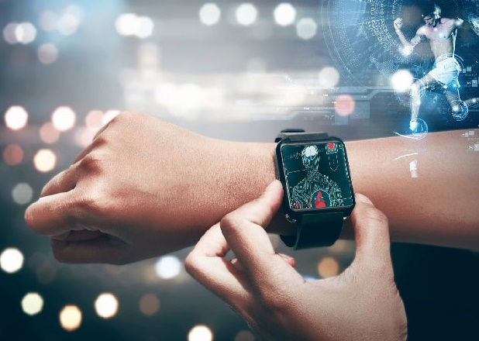
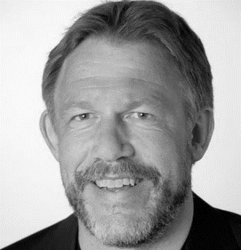
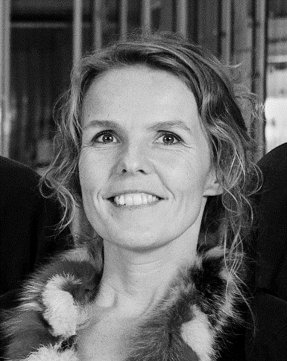
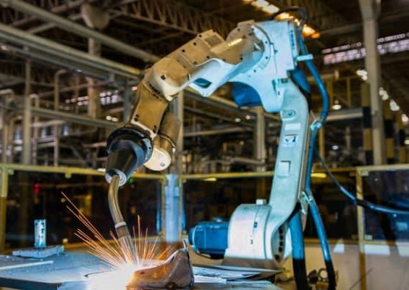
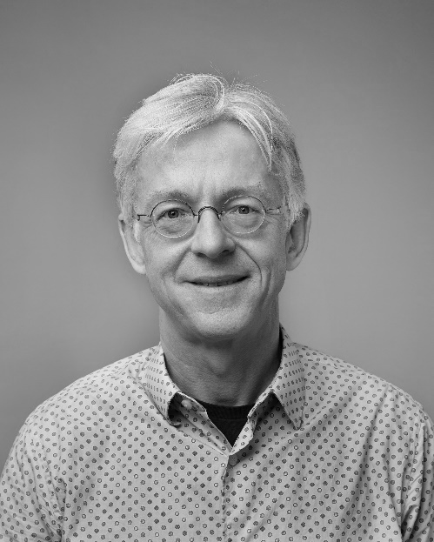
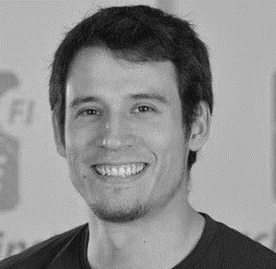
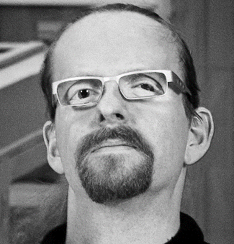
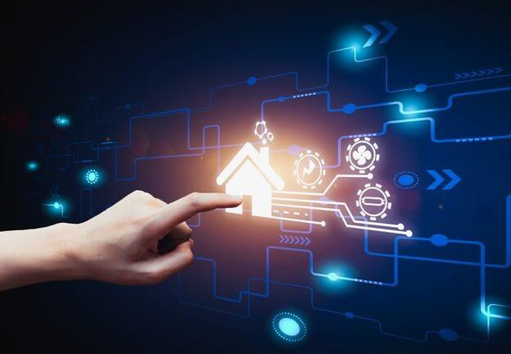
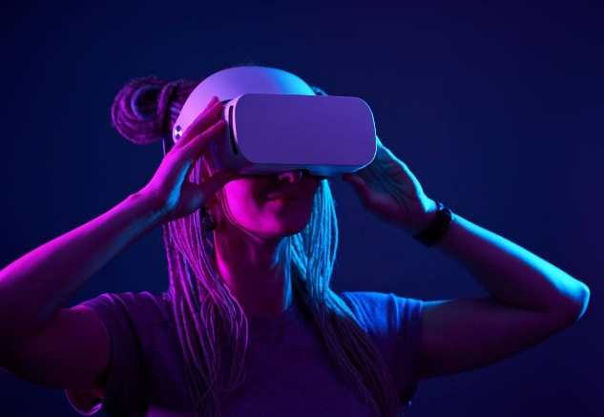
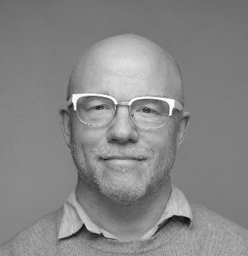
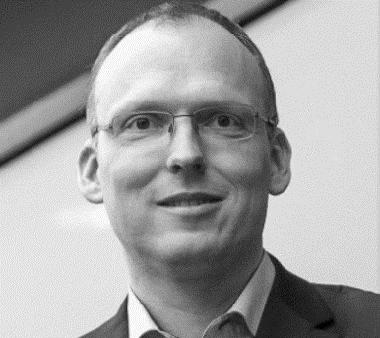

KAJ
MARIANNE
HANS
KEN
NIELS OLOF
NIKLAS
HANS-JÖRG

Slide 3
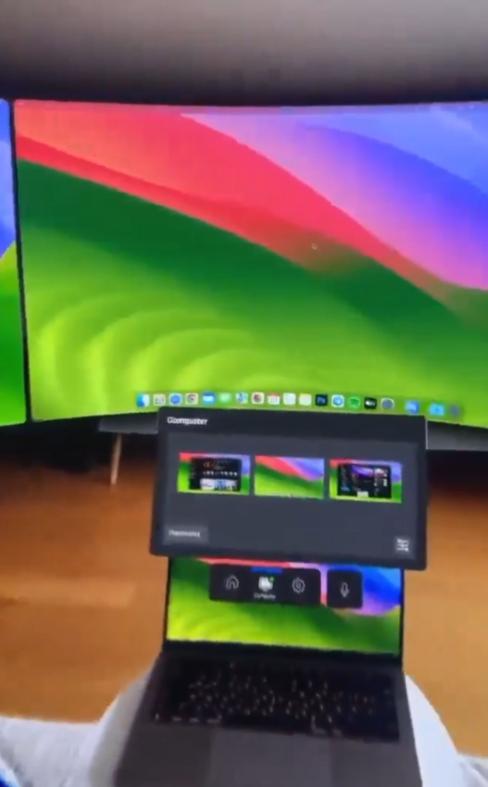
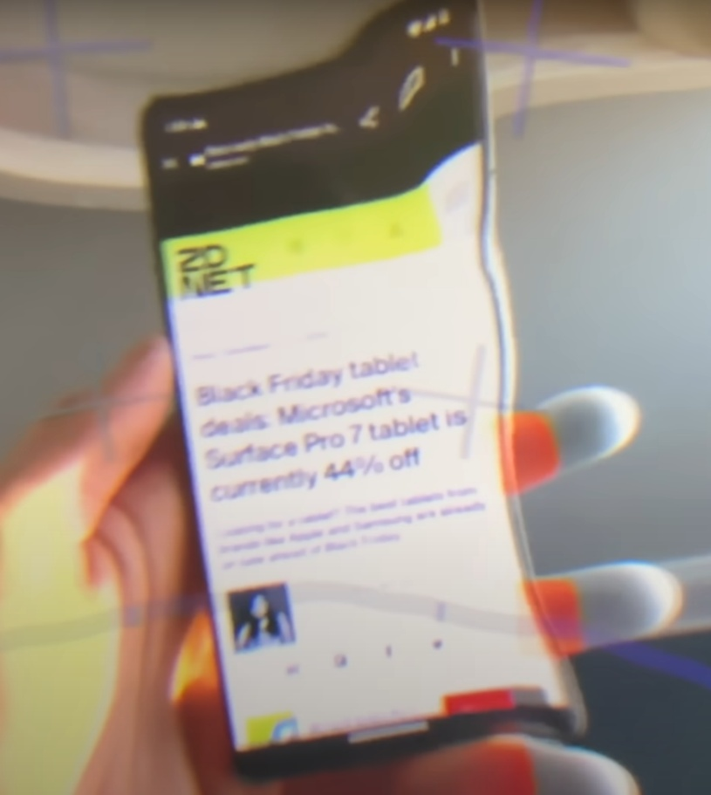
[UBI-B] Exploring Layers of Mixed Reality
How to mix virtual content and real screens?
How to interact consistently with mixed content in MR?
How to use gaze tracking across different layers of reality?
Notes:
Remote Manipulation; Drag & Drop in Space

Slide 4
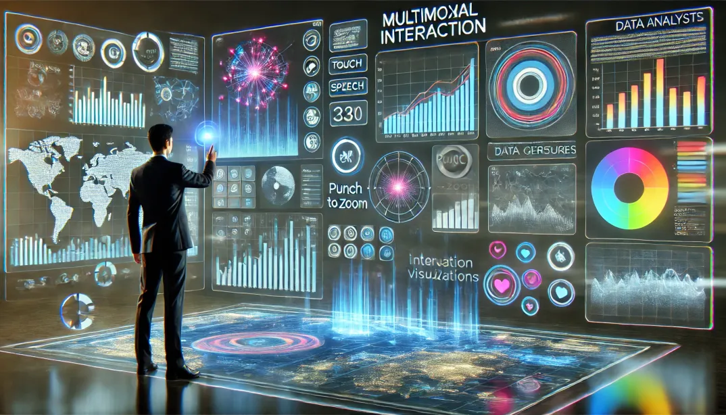
[UBI-C] Gestures, Speech, and Touch for Visualization Dashboards
Can we make use of different input modalities to provide a richer interactive dashboard experience?

Slide 5
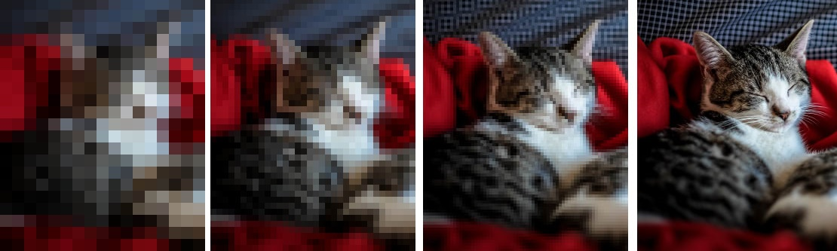
[UBI-E] Progressive Visualization Techniques
Progressive JPEG
Progressive Visualization

Slide 6
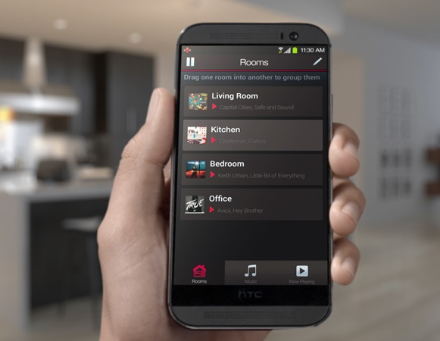
[UBI-G] Seamless Music Streaming
Transitions
Room to Room
Phone to Stereo
Playlist A to Playlist B
Sensors for spatial, temporal, and social context

Slide 7
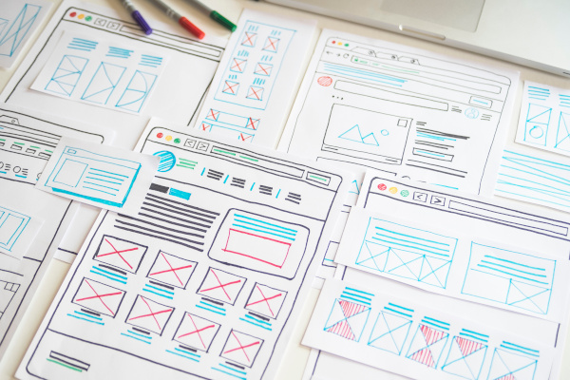
[UBI-I] Expanding the Interaction with LLMs
Design novel interaction patterns for LLMs (ChatGPT)
Graphical user interface design for LLMs
Real-time integration with LLM APIs
Implementation of interactive prototypes
User testing and evaluation

Slide 8
UBI BSc Projects
If you want to know more come to the information meeting right after or drop an email to the respective project contact.

